Slide 1
CODE BRIDGE -Bridging the gap between Coders Project Guide- Pranita Manjare
FY-MCA , DIV- C
Project by:-
142 - Akanksha Rajendra Job
173 – Rohit Gopal Shinde

Slide 2
Project Objectives
Real-Time Collaboration: Develop a platform where multiple coders can write, edit, and review code simultaneously, making collaboration seamless.
Enhanced Learning & Innovation: Enable users to pair program, share knowledge, and learn from one another in a live coding environment.
Universal Accessibility: Provide a web-based solution that works across devices and locations, eliminating compatibility issues.
Integrated Communication: Notification features to support instant communication during coding sessions.

Slide 3
Scope of Work
Frontend Development: Create an intuitive user interface featuring a powerful code editor (with syntax highlighting, auto-completion, etc.) and integrated communication tools.
Backend Development: Implement server-side logic to handle real-time data synchronization, user management, and session control.
Real-Time Communication: Utilize technologies like WebSockets to ensure instant updates across all users in a coding session.
User & Session Management: Develop features for user authentication, profile management, and seamless creation/joining of collaborative sessions.
Optional Code Execution: Integrate an environment where users can run code snippets and see immediate outputs.
Deployment & Scalability: Ensure the system is deployable on cloud platforms, using containerization tools like Docker for efficient scaling.

Slide 4
Technology Used
Frontend:
Frameworks/Libraries: React for building a responsive and dynamic interface.
Code Editor: CodeMirror Editor for a feature-rich coding environment.
Styling: HTML5, CSS3 ,Bootstrap .
Backend:
Server Framework: Node.js with Express.js for handling server operations.
Real-Time Communication: Socket.IO or similar WebSocket libraries.

Slide 5
Module Specification
User Management Module
2. Session Management Module
3. Real Time Editor Module
4. Collaboration Module
5. Code Execution Module
6. Notification Module
7. Data Storage Module

Slide 6
INDEX
Context level DFD
First level DFD
ERD
Use Case Diagram
Class Diagram
Activity Diagram
Sequence Diagram

Slide 7
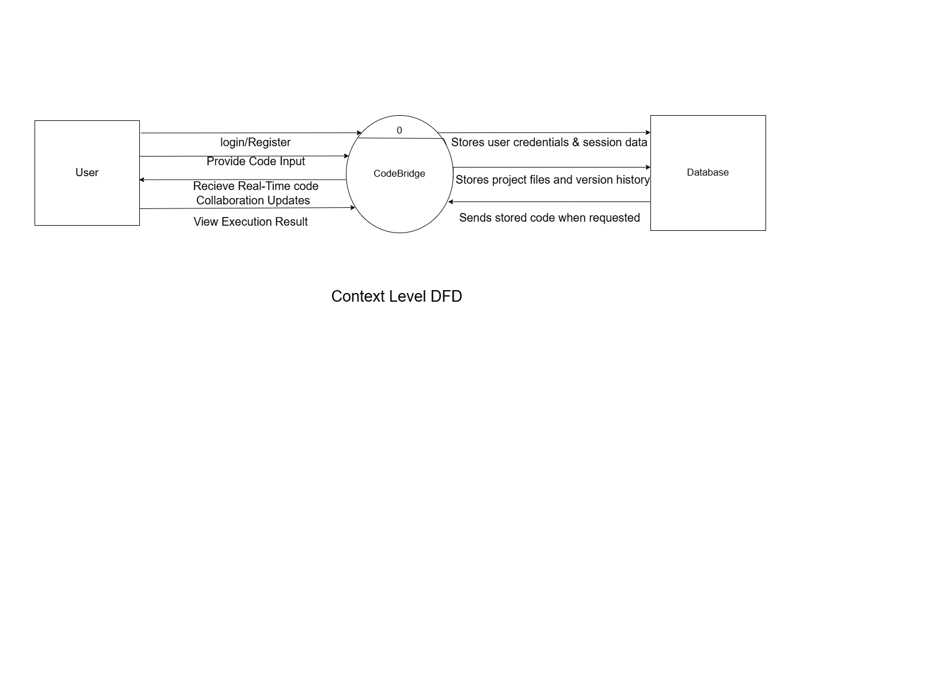
1. CONTEXT LEVEL DIAGRAM

Slide 8
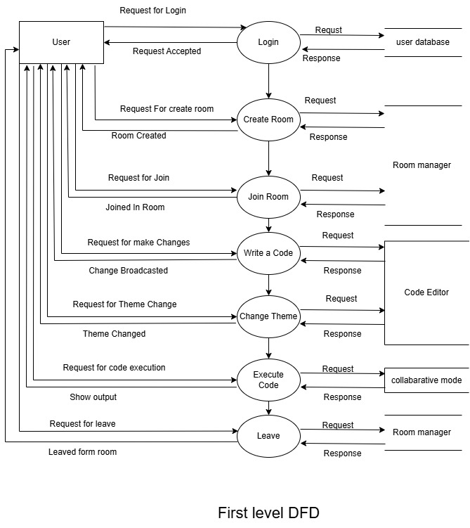
2.FIRST LEVEL DFD
1.0
3.0
2.0

Slide 9
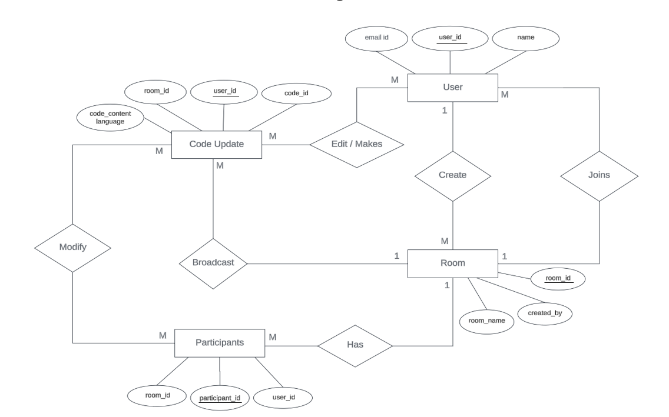
3.ERD DIAGRAM

Slide 10
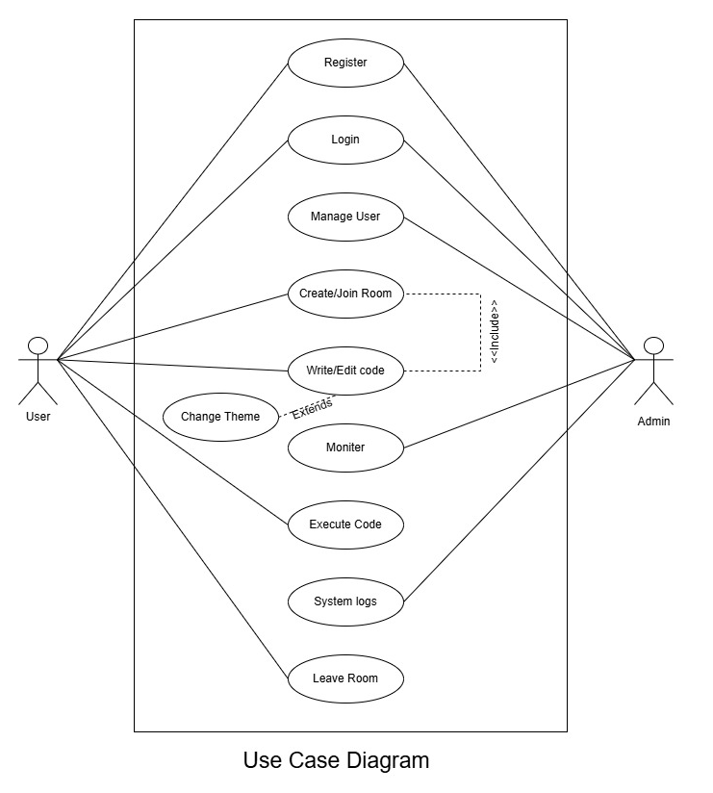
4. USE CASE DIAGRAM

Slide 11
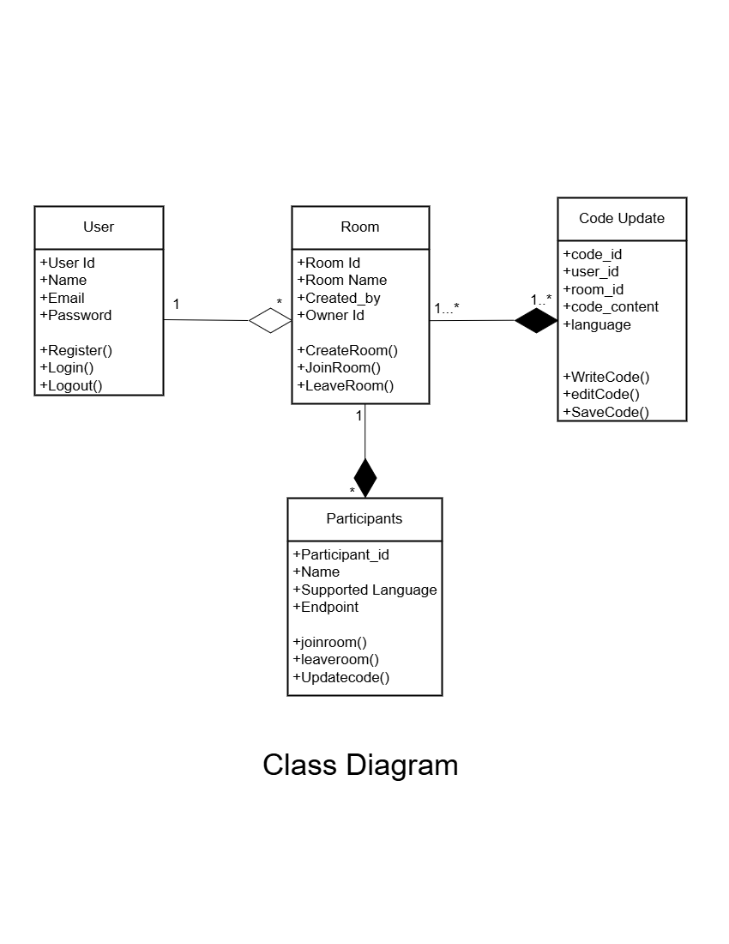
5.CLASS DIAGRAM

Slide 12
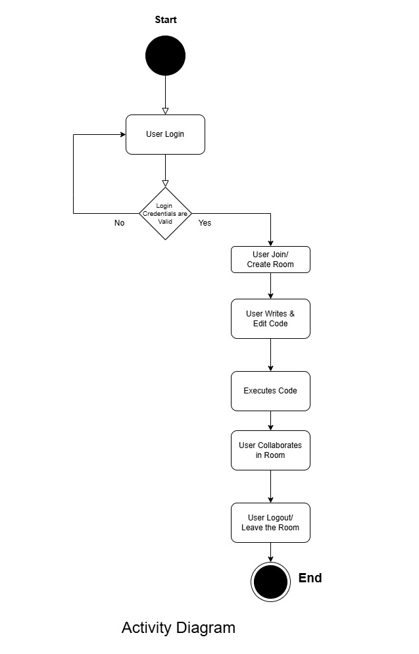
6.ACTIVITY DIAGRAM

Slide 13
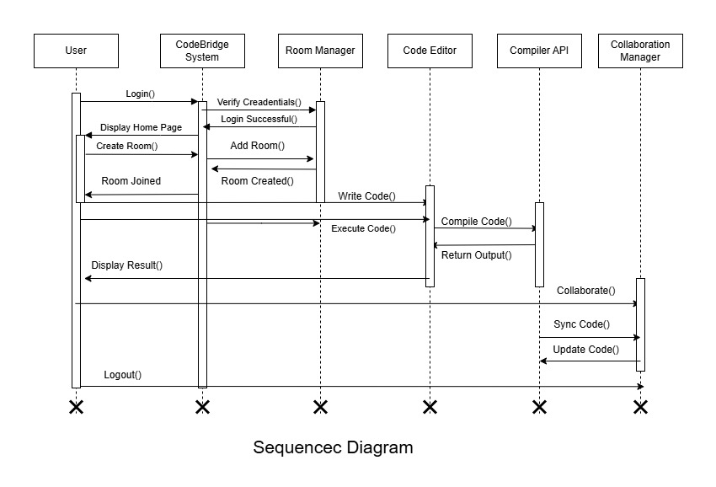
7.SEQUENCE DIAGRAM

Slide 14

Thank you

